Slide 1
D6780 Grant Qualification & Management Seminar
TITLE
Fall 2020
For the 21-22 Rotary Year

Slide 2
Welcome!
Notes:
DDF and WF available to help – big time. With the end of Polio coming soon, we need to build our capability to do grants. We have big players, like B&MG that are ready to help if we can do it.

Slide 3
Rules of the Road
Notes:
DDF and WF available to help – big time. With the end of Polio coming soon, we need to build our capability to do grants. We have big players, like B&MG that are ready to help if we can do it.

Slide 4
Mute yourself
Stay muted
Leave your camera on
Ask questions in chat
Notes:
Districts 6860 gave 3,987
Districts 6780, 6880, 6760, 6800, and 6710 gave $1,200 each
WF match = $31, 036

Slide 5
And the answer is . . .
Notes:
DDF and WF available to help – big time. With the end of Polio coming soon, we need to build our capability to do grants. We have big players, like B&MG that are ready to help if we can do it.

Slide 6
GOALS FOR ATTENDEES AND THEIR CLUBS:
Understand the basics and the timeline
Understand how to successfully manage a District Grant
Understand stewardship expectations
Be able to complete the Memorandum of Understanding (MOU)
Qualify clubs with members attending to receive Rotary Foundation grant funds and participate in Foundation programs
Notes:
Districts 6860 gave 3,987
Districts 6780, 6880, 6760, 6800, and 6710 gave $1,200 each
WF match = $31, 036

Slide 7
AGENDA
OVERVIEW Debbie Alexander-Davis
CLUB QUALIFICATION Debbie Alexander-Davis
CREATING A PROJECT Debbie Alexander-Davis
APPLYING FOR A GRANT Pat White
Rachel Killebrew
PROJECT IMPLEMENTATION Pat White
Rachel Killebrew
Notes:
Districts 6860 gave 3,987
Districts 6780, 6880, 6760, 6800, and 6710 gave $1,200 each
WF match = $31, 036

Slide 8
OVERVIEW
Debbie Alexander-Davis
District Rotary Foundation Chair
Notes:
DDF and WF available to help – big time. With the end of Polio coming soon, we need to build our capability to do grants. We have big players, like B&MG that are ready to help if we can do it.

Slide 9
21-22 DG TIMELINE
PE and Club identify project in 2020
Club becomes qualified to submit a district grant application by 2 members attending training and
Club Memorandum of Understanding and Club Qualification Plan are submitted – may be submitted prior to application being submitted or submitted together
Applications accepted Oct. 1, 2020 to Jan. 31, 2021
Applications reviewed and approved beginning Feb. 1, 2021
All DG applications are bundled and submitted to The Rotary Foundation for approval – target date March – April, 2021

Slide 10
21-22 DG TIMELINE (continued)
TRF approves the bundled district grants and clubs are notified they may begin their project – target date May 2021
Project is carried out
Progress report due midway through the project and no later than October 1, 2021
Final report due by May 31, 2022 including receipts for all expenditures
District disburses funds on approval of final report.

Slide 11
FUNDING BASICS
District grants must be humanitarian but they are NOT limited to the seven areas of focus (see next slide)
May be local or international
District grants are funded by donations D6780 Rotarians make to the Annual Fund three years prior.
For 21-22 District Grants, donations from the 18-19 Rotary year fund the grants.

Slide 12
Rotary’s Seven Areas of Focus
Peacebuilding and Conflict Prevention
Water, Sanitation, and Hygiene
Basic Education and Literacy
Disease Prevention and Treatment
Maternal and Child Health
Community Economic Development
Environment – currently being added for 21-22

Slide 13
ANNUAL PROGRAMS FUND
50%
50%
SHARE
District Controlled
Trustees Controlled
District Designated Fund
World
Fund
Other
(Cash, DAF, Endowment Fund)
50% (max)
50% (min)
District Grants
Global Grants
(World Fund match
to DDF and cash)

Slide 14
2021- 2022 Funding
ANNUAL FUND Donations = $611,381
50%
50%
SHARE
District Controlled
Trustees Controlled
District Designated Fund
World
Fund
Other
(Cash, DAF, Endowment Fund)
$305,690
50% (max)
50% (min)
District Grants
Global Grants
(World Fund match
to DDF and cash)
$152,845

Slide 15
Grant Management – Ensures that your grant
Has proper financial controls in place
Is guided by humanitarian and educational principles
Meets the needs of the beneficiaries
Fulfills its objectives based on a community assessment
Safeguards donor funds

Slide 16
Stewardship
Responsible management and oversight of grant funds
  Rotarian supervision of project
  Standard business practices are used
  Irregularities are reported to The Rotary Foundation
  Projects are implemented as approved
  Financial records are reviewed
  Reports are submitted in a timely fashion

Slide 17
Terms of Qualification
Valid for one Rotary Year – Clubs must requalify each year
The club as an entity is responsible for the use of the funds
Potential conflicts of interest must be disclosed
The club must cooperate with all audits
Grant funds must be used properly

Slide 18
CLUB QUALIFICATION
Debbie Alexander-Davis
District Rotary Foundation Chair
Notes:
DDF and WF available to help – big time. With the end of Polio coming soon, we need to build our capability to do grants. We have big players, like B&MG that are ready to help if we can do it.

Slide 19
Qualification Requirements
Attendance at this district Rotary Foundation Grant Management Seminar by 2 club members
Agreement with the Club Memorandum of Understanding (MOU)
Submission of a Club MOU
Completion and approval of the Qualification Plan

Slide 20
Club Requalification
Required annually
Review last year’s Qualification Plan
  Do you understand what was written?
  Did you do what you wrote?
  Was it good enough?
Modify and resubmit Qualification Plan
Sign new Memorandum of Understanding (MOU)

Slide 21
Maintaining Qualification
Follow the terms of the Club MOU
Fully implement stewardship and grant management practices to prevent misuse of funds
Appoint a club member or committee to manage club qualification

Slide 22
Club Qualification Plan
What MOU requirements does your club already implement?
What requirements does your club need to implement?
What type of club members would be good choices to help implement the Club MOU?

Slide 23
Club Qualification Plan – Best Practices/Issues
Manager
Conflicts of Interest
Training
Bank Account
Financial Management Plan
Document Retention
Reports
Misuse Plan
Approval

Slide 24
Questions?
Please ask them
using the chat feature!

Slide 25
CREATING A PROJECT
Debbie Alexander-Davis
District Rotary Foundation Chair
Notes:
DDF and WF available to help – big time. With the end of Polio coming soon, we need to build our capability to do grants. We have big players, like B&MG that are ready to help if we can do it.

Slide 26
Objectives
Identify best practices for choosing a project
Develop a plan to implement your project
Understand what is needed to establish a financial management plan

Slide 27
Successful Grant Projects
Meet real community needs
Have frequent personal partner communication
Have implementation plans with measurable goals and outcomes
Are sustainable beyond the life of the grant
Practice proper stewardship of grant funds

Slide 28
Community Assessment
Talk with partners and members of the community
Assess your club’s resources and availability and its potential partners to meet the need
Choose a project that is based on what the community needs, not what you want to do!

Slide 29
Partners
How can partners help you make your project more successful?
How do you go about identifying potential partners?
  What about other Rotary clubs in your community?
  Are there other non-profits or NGOs or government organizations who can partner with you to make the project a lasting success?

Slide 30
Project Planning
Form a 3-person grant committee
Assign roles
Set measurable and sustainable goals
Create a budget
Create an implementation plan
Have a contingency plan

Slide 31
Creating a Budget
Realistic
Competitive bidding
Reasonable prices
Disclose potential or real conflicts of interest

Slide 32
Questions?
Please ask them
using the chat feature!

Slide 33
TIME FOR A BREAKout!
Notes:
DDF and WF available to help – big time. With the end of Polio coming soon, we need to build our capability to do grants. We have big players, like B&MG that are ready to help if we can do it.

Slide 34
Breakout Question
What is the most
important thing
you have learned so far?

Slide 35
APPLYING FOR A DISTRICT GRANT
Rachel Killebrew
District Grant Reader
Pat White
District Grant Coordinator
Notes:
DDF and WF available to help – big time. With the end of Polio coming soon, we need to build our capability to do grants. We have big players, like B&MG that are ready to help if we can do it.

Slide 36
Learning Objectives
Be able to write a successful grant proposal and application
Understand good stewardship practices

Slide 37
District Grants Forms
Direct link to download forms was emailed to you with the
zoom link.
Forms also found on the District 6780 Website
(rotarydistrict6780.com):
  Instructions
  Timeline
  District Grant Checklist
  Club Qual and MOU
  Single Club Application
  Multi Club Application
  District Grant Progress Report
  District Grant Final Report

Slide 38
21-22 DG Application Sections
Sponsor
Project Funding
  Requested Funds
  Club Matching Funds – must exceed or match requested funds
  Other Funds
  Total Funds
Project Description
  Name
  Humanitarian Need
  Goal and Measurable Objectives

Slide 39
21-22 DG Application Sections (cont.)
Project Description (cont.)
  Location
  Need
  Target Population, Expected #s Impacted
  Action Plan – who does what when
  Outcomes and Impact
  Financial Control
  Sustainability

Slide 40
21-22 DG Application Sections (cont.)
Timeline
Non-Financial Rotarian Involvement
Publicity
Responsible Rotarians (2)
Cooperating Organizations (if any)
Budget
  detailed and itemized
  must match total funds requested in Part 2
Certification

Slide 41
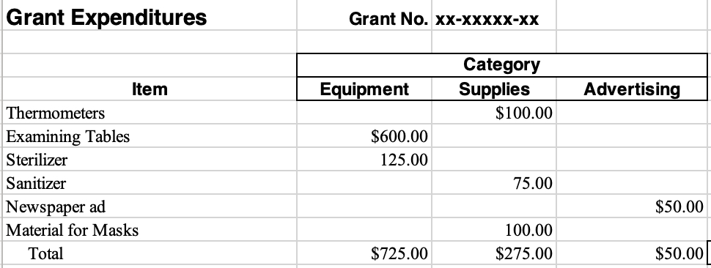
SAMPLE BUDGET

Slide 42
DISTRICT GRANT CHECKLIST
Are all District Grant and Global Grant reports up to date?
Is your club grant qualified for 21-22?
  Two club members attended DG qualification training
  Club Qualification and Club Memorandum of Understanding have been completed and sent to Pat White and David Carroll
Has someone else read the grant application for completeness?
Does the timeline match the DG timeline (April 1, 2021 to March 31, 2022)?
Do you describe how those in need will be helped?
Is there Rotarian involvement?

Slide 43
DISTRICT GRANT CHECKLIST (cont.)
How can the benefits be sustained?
Has a project chair been selected & contact info provided?
Is your budget detailed and included?
Do all expenses meet grant restrictions?
Are all partners listed? Do their contributions match budget?
Is the application signed by the President or PE? Does the PE understand his or her responsibilities?
Are letters of support from cooperating partners included?
Have all documents been copied before submitting to DG committee?

Slide 44
Questions?
Please ask them
using the chat feature!

Slide 45
IMPLEMENTATION AND REPORTING
Rachel Killebrew
District Grant Reader
Pat White
District Grant Coordinator
Notes:
DDF and WF available to help – big time. With the end of Polio coming soon, we need to build our capability to do grants. We have big players, like B&MG that are ready to help if we can do it.

Slide 46
Objectives
Understanding how to monitor the progress of your plan
Gain best practices for managing funds and record keeping
Discuss the importance of evaluating a project and applying the lessons learned
Understand the reporting requirements

Slide 47
Successful Project Implementation
Personal Contact
Communication
Financial Management
Record Keeping
Following the Original Plan

Slide 48
Evaluation
Ongoing during project implementation and project completion
Based on goals set for the project
Assists with reporting requirements
Use the findings to improve future projects and identify successes you can promote!

Slide 49
District Grant Reports
A progress report is due October 1, 2021
All grants should be completed by March 31, 2022
A final report (including receipts) is due within 2 months of project completion or by May 31, 2022 (whichever comes first)
The final report must be approved by the District Grant Team before the grant funds will be paid

Slide 50
District Grant Progress Report Sections
  Project Description
  Rotarian Participation
    How many?
    What have they done?
  Project Status
    What has been completed?
    What is left to complete?
    On schedule for completion?

Slide 51
District Grant Progress Report Sections (cont.)
  Funding to Date
  Expenditures to Date
  Amount of District Grant Funds Expected to Be Requested
  Certification

Slide 52
District Grant Final Report Sections
  Project Description
  Rotarian Participation
    How many?
    What have they done?
  Project Impacts
    How many non-Rotarians benefited?
    Expected long term benefits?
    Role of any cooperating organization?

Slide 53
District Grant Final Report Sections (cont.)
  Funding
  Expenditures
  Amount of District Grant Funds Requested
  Certification
Receipts sorted and labeled by budget category
MUST be attached to the final report!

Slide 54
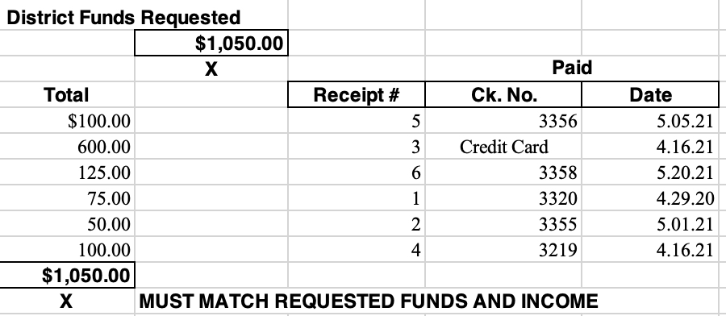
DISTRICT FUNDS REQUESTED

Slide 55
Questions?
Please ask them
using the chat feature!

Slide 56
How Did It Go?
Notes:
DDF and WF available to help – big time. With the end of Polio coming soon, we need to build our capability to do grants. We have big players, like B&MG that are ready to help if we can do it.

Slide 57
DISTRICT 6780 DISTRICT GRANT CONTACTS:
David Carroll, District Grants Chair
  Cell: 423.595.3503
  dcarroll1960@aol.com
Pat White, 21-22 District Grant Coordinator
  Cell: 865.236.2072
  pkmsw@aol.com
Notes:
Districts 6860 gave 3,987
Districts 6780, 6880, 6760, 6800, and 6710 gave $1,200 each
WF match = $31, 036

Slide 58
Thank You!
Notes:
DDF and WF available to help – big time. With the end of Polio coming soon, we need to build our capability to do grants. We have big players, like B&MG that are ready to help if we can do it.

